Slide 1
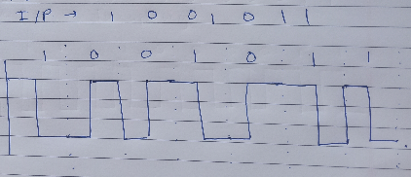
I/P- 1001011
Manchester Encoding

Slide 2
Network Layer
The network layer is concerned with getting packets from the source all the way to the destination.
The Network layer is the lowest layer that deals with end-to-end transmission.
To achieve its goals, the network layer must know about the topology of the communication subnet (i.e., the set of all routers) and choose appropriate paths through it.
It must also take care to choose routes to avoid overloading some of the communication lines and routers while leaving others idle. Finally, when the source and destination are in different networks, new problems occur. It is up to the network layer to deal with them.
To achieve this while designing network layer we need to deal with the some issues

Slide 3
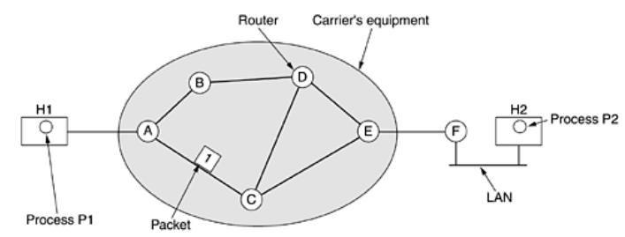
Network Layer Design Issues
Store-and-Forward Packet Switching
Host H1 is directly connected to one of the carrier's routers, A, by a leased line. In contrast, H2 is on a LAN with a router, F, owned and operated by the customer. This router also has a leased line to the carrier's equipment. We have shown F as being outside the oval because it does not belong to the carrier, but in terms of construction, software, and protocols, it is probably no different from the carrier's routers. Whether it belongs to the subnet is arguable, but for the purposes of this chapter, routers on customer premises are considered part of the subnet because they run the same algorithms as the carrier's routers

Slide 4
Network Layer Design Issues
This equipment is used as follows. A host with a packet to send transmits it to the nearest router, either on its own LAN or over a point-to-point link to the carrier. The packet is stored there until it has fully arrived so the checksum can be verified. Then it is forwarded to the next router along the path until it reaches the destination host, where it is delivered. Thismechanism is store-and-forward packet switching,

Slide 5
Network Layer Design Issues
Services Provided to the Transport Layer
The network layer services have been designed with the following goals
The services should be independent of the router technology.
The transport layer should be shielded from the number, type, and topology of the routers present.
The network addresses made available to the transport layer should use a uniform numbering plan, even across LANs and WANs.
Based on these goals connectionless and connection oriented service provided.

Slide 6
Network Layer Design Issues
Store-and-Implementation of Connectionless Service
If connectionless service is offered, packets are injected into the subnet individually and routed independently of each other. No advance setup is needed.
In this context, the packets are frequently called datagrams and the subnet is called a datagram subnet.
How a datagram subnet works?

Slide 7
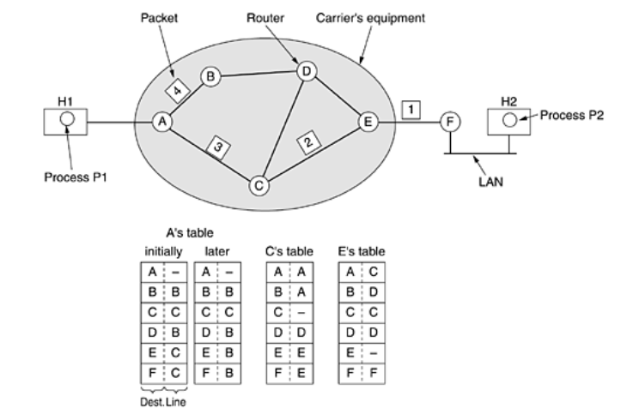
Network Layer Design Issues

Slide 8
Network Layer Design Issues
Assume that the message is four times longer than the maximum packet size, so the network layer has to break it into four packets, 1, 2, 3, and 4 and sends each of them in turn to router A using some point-to-point protocol, for example, PPP.
At this point the carrier takes over. Every router has an internal table telling it where to send packets for each possible destination.
Each table entry is a pair consisting of a destination and the outgoing line to use for that destination. Only directly-connected lines can be used.
A has only two outgoing lines—to B and C—so every incoming packet must be sent to one of these routers, even if the ultimate destination is some other router. A's initial routing table is shown in the figure under the label ''initially.''
The algorithm that manages the tables and makes the routing decisions is called the routing algorithm.

Slide 9
Network Layer Design Issues
Implementation of Connection-Oriented Service
In connection-oriented service is used, a path from the source router to the destination router must be established before any data packets can be sent.
This connection is called a VC (virtual circuit), in analogy with the physical circuits set up by the telephone system, and the subnet is called a virtual-circuit sub.
How VC sunet works?

Slide 10
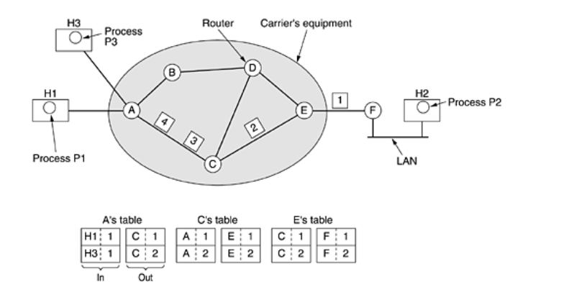

Slide 11
Network Layer Design Issues
Instead, when a connection is established, a route from the source machine to the destination machine is chosen as part of the connection setup and stored in tables inside the routers.
That route is used for all traffic flowing over the connection, exactly the same way that the telephone system works. When the connection is released, the virtual circuit is also terminated.
With connection-oriented service, each packet carries an identifier telling which virtual circuit it belongs to.
Host H1 has established connection 1 with host H2. It is remembered as the first entry in each of the routing tables.
The first line of A's table says that if a packet bearing connection identifier 1 comes in from H1, it is to be sent to router C and given connection identifier 1. Similarly, the first entry at C routes the packet to E, also with connection identifier 1.

Slide 12
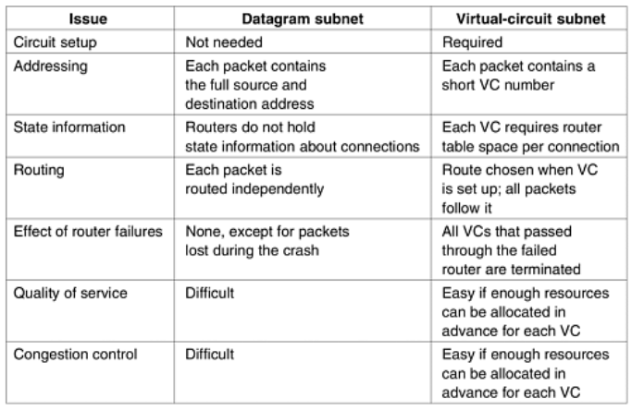
Comparison of Virtual-Circuit and Datagram Subnets

